Slide 1
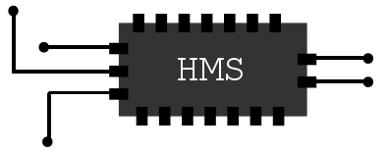

SMACNI to AVX512 the life cycle of an instruction set
Presented at Handmade Seattle www.handmade-seattle.com/
Why 29%* of x86 is my** fault***
Tom Forsyth
November 2019
* Dubious accounting methods detected!
** And a whole bunch of other people of course
*** #UD if CR4.OSXSAVE=0

Slide 2
Caveats
Focusing on the Larrabee-derived instruction set, not the device.
All this is from memory, so may not be 100% accurate!
Lots and lots of people involved – far too many to name.
(this is the Director’s Cut Extended Edition of the slides)
Not even remotely an official Intel document/guide/spec sheet.

Slide 3
Levels of hardware
User-level architecture
Register count & size
Instruction set, encoding
OS-level architecture
Supervisor states and faulting
Virtual memory table structures
Hyperthreading, non-uniform memory arch
Micro-architecture (“uarch”)
Cache size/ways/tags, branch prediction
Number & type of pipeline stages, latency
In/out-of-order, number & type of ALUs
Design
Physical layout, timing, power & clock gating, clock trees, etc

Slide 4
Innovation in ISA (instruction set architecture)
A mix of both history and technology.
Design constraints drive uarch.
New uarch usually demands new ISA to drive it (e.g. wider SIMD).
ISA is always in the context of the mechanical function of the machine you are building it for (uarch), and the two interact tightly.
And sometimes design drives effects all the way up to arch.

Slide 5
Innovation becomes legacy!
Future machines with different design & uarch then need to cope with the “legacy” architecture that made sense for the old design.
This is not a unique problem for x86!
Branch delay slot in MIPS
Register stack/window in SPARC
ARM predication and “free” shifter

Slide 6
Innovation becomes legacy!
Future machines with different design & uarch then need to cope with the “legacy” architecture that made sense for the old design.
This is not a unique problem for x86!
Branch delay slot in MIPS
Register stack/window in SPARC
ARM predication and “free” shifter
Before rolling your eyes at an instruction or feature, consider it may have made perfect sense when it was invented, and that reason may never have been visible to you as a programmer.

Slide 7
Pixomatic (~2004)
Software rast by Michael Abrash & Mike Sartain, RAD Game Tools
Standard MMX/SSE, JIT-compiled from DX7-style render states
2 textures, 3 blend stages
All integer shading
Planning Pixomatic 2
Wanted FMA instruction in x86
Talked to Dean Macri of Intel at GDC…

Slide 8
SMCA (~2005)
A large array of simple, power-efficient x86 cores
SMCA = “Symmetric Multi-Core Architecture”
Concept from Doug Carmean and Eric Sprangle of Intel
Original idea from ~2003
Assumed (correctly!) that future would be limited by power, not area
But where do they find “embarrassingly parallel” workloads to give it?
GPGPU and/or multicore wasn’t a common “thing” yet

Slide 9
SMCA (~2005)
A large array of simple, power-efficient x86 cores
SMCA = “Symmetric Multi-Core Architecture”
Concept from Doug Carmean and Eric Sprangle of Intel
Original idea from ~2003
Assumed (correctly!) that future would be limited by power, not area
But where do they find “embarrassingly parallel” workloads to give it?
GPGPU and/or multicore wasn’t a common “thing” yet
Answer – graphics?
Michael Abrash + Mike Sartain started on the “fixed function” pipeline
I started writing a DX shader -> SSE shader compiler

Slide 10
SMCA New Instructions
Quickly realized that just adding FMA to SSE wasn’t enough
128 bits wide was inefficient – not enough FMA per core
Sod it – we’re making a whole new ISA – “SMCA New Instructions”
BUT – still has to be x86-like
Remember job #1 is general-purpose computing – graphics is just a workload
C, Fortran, etc, (not just shaders)
Run FreeBSD/Linux and multitasking
Virtual memory, page faults, etc
User/supervisor levels
x86 memory ordering model

Slide 11
SMCANI early decisions (~2007)
FMA is obviously good
As wide as possible – couldn’t build 1024 bits, so 512 it was
16 lanes of float32
Also matched x86 cache-line size
“Ternary” encoding – needed for FMA, but also generally useful
Removes a lot of extra copy inst, compared to SSE-style destructive binary
Load-op: vaddps v0, v1, [rax]
Used by approx. 50% of maths instructions
Removes a lot of separate load instructions

Slide 12
How to develop an ISA
Gather shader workloads from games
Compile to SMCANI with compiler
Add new instruction or change architecture
Change compiler to use new thing
Run through simulators to gauge performance & power
Accept/reject new thing
Iterate like crazy
Hugely powerful
Typically managed a week for a new architectural feature
A new instruction was a day
Tried a massive number of features and combos
Lots of “interesting ideas” the compiler couldn’t deal with – rejected!
This also informs the design of the surrounding “fixed function” pipe

Slide 13
SMCA core choice
Which core do we start with?
Both need major surgery to support 512-bit SIMD units + 4 threads
P54C – version of the original Pentium
Last Intel in-order core
Needs to be expanded to 64-bit
No existing MMX/SSE
But… Ed Grochowski
Bonnell (Atom 1)
New, modern x86 ISA, 64-bit, already has MMX/SSE
But that team was heads-down trying to ship
P54C was judged the lowest risk (in retrospect – correct decision)

Slide 14
P54C pairing and “free” memory
P54C pairing: two decode+execute pipes
“Fat” U pipe can execute any instruction. The SIMD ALU hangs off this pipe
“Thin” V pipe can execute scalar instructions, and SIMD store
Compiler high goals
Keep the U pipe full of SIMD math instructions all the time
Use the V pipe for “life support” scalar instructions and vector stores
Address computation
Loop counters
Branches
Vector stores
Load-op on U and store on V means memory is often “free”

Slide 15
P54C details shaped the ISA
Example of microarchitecture driving architecture and ISA
Dual-issue fat+thin pipes
Requires load-op in the ISA to support it
Vector stores remain cheap
Before committing to this, we HAD to prove the compiler can cope
And indeed it could
Lots of other interesting ideas rejected because compiler couldn’t cope
When designing an ISA, write the compiler first!
Looking forwards, these limits help all architectures
But be careful of painting yourself into a corner when the uarch changes!

Slide 16
P54C pairing and load-op
 | Pipe | RF reads | RF writes | Total per clock
vmadd v0, v1 , v2 | U | v0, v1, v2 | v0 | 3R, 2W
vload v3, [rax] | V |  | v3
vmadd v0, v4, v3 | U | v0, v4, v3 | v0 | 4R, 1W
vstore [rbx], v5 | V | v5
Req: 4R, 2W

Slide 17
P54C pairing and load-op
 | Pipe | RF reads | RF writes | Total per clock
vmadd v0, v1 , v2 | U | v0, v1, v2 | v0 | 3R, 2W
vload v3, [rax] | V |  | v3
vmadd v0, v4, v3 | U | v0, v4, v3 | v0 | 4R, 1W
vstore [rbx], v5 | V | v5
Load-op
Req: 4R, 2W
 | Pipe | RF reads | RF writes | Total per clock
vmadd v0, v1 , v2 | U | v0, v1, v2 | v0 | 3R, 1W
vmadd v0, v4, [rax] | U | v0, v4 | v0 | 3R, 1W
vstore [rbx], v5 | V | v5
Req: 3R, 1W

Slide 18
P54C pairing and load-op
 | Pipe | RF reads | RF writes | Total per clock
vmadd v0, v1 , v2 | U | v0, v1, v2 | v0 | 3R, 2W
vload v3, [rax] | V |  | v3
vmadd v0, v4, v3 | U | v0, v4, v3 | v0 | 4R, 1W
vstore [rbx], v5 | V | v5
Load-op
Req: 4R, 2W
Significant reduction in area and power for the register file
 | Pipe | RF reads | RF writes | Total per clock
vmadd v0, v1 , v2 | U | v0, v1, v2 | v0 | 3R, 1W
vmadd v0, v4, [rax] | U | v0, v4 | v0 | 3R, 1W
vstore [rbx], v5 | V | v5
Req: 3R, 1W

Slide 19
Encoding
Three different and sadly incompatible encodings
Constant tension between the needs of a simple in-order core and a complex out-of-order Big Core
KNF: D6 (SALC) and 62 (BOUND) prefixes – only free in 64-bit mode
KNC: 62 + 3 byte “MVEX” prefix used for all instructions
KNL/AVX512: MVEX tweaked to become current “EVEX” prefix

Slide 20
Encoding
Three different and sadly incompatible encodings
Constant tension between the needs of a simple in-order core and a complex out-of-order Big Core
KNF: D6 (SALC) and 62 (BOUND) prefixes – only free in 64-bit mode
KNC: 62 + 3 byte “MVEX” prefix used for all instructions
KNL/AVX512: MVEX tweaked to become current “EVEX” prefix
Convergence was extremely painful
The REAL cost of x86 legacy is not gates, it’s lots and lots of meetings
Cunning-but-complex encoding tricks used to avoid existing x86 instructions

Slide 21
Memory faults
From a programming viewpoint they:
Are esoteric
Get in your way
Never happen
Why do I even care?

Slide 22
Memory faults
From a programming viewpoint they:
Are esoteric
Get in your way
Never happen
Why do I even care?
From an OS viewpoint they:
Are how virtual and demand-paged memory works at all
Happen constantly
Are incredibly important to get right
Very subtle – small changes in HW behavior can cause deadlocks/livelocks

Slide 23
Memory faults
From a programming viewpoint they:
Are esoteric
Get in your way
Never happen
Why do I even care?
From an OS viewpoint they:
Are how virtual and demand-paged memory works at all
Happen constantly
Are incredibly important to get right
Very subtle – small changes in HW behavior can cause deadlocks/livelocks
P54C WASN’T BROKEN, SO DON’T TRY TO FIX IT!

Slide 24
Memory faults
P54C pipeline was simple, small, short, but simple:
Faults must be taken immediately after TLB lookup
Go/nogo point is at the same time as the cache read
Once an instruction has passed that point, CANNOT fail or fault or stop
Therefore, must take/eliminate the fault before any “work”
Can’t do 4 clocks of work THEN find a problem and take a fault
Entire vector-maths pipeline is after go/nogo point
Cannot look up TLB more than once
Otherwise you need slow microcode or sequencing
Therefore can only hit one cache line per instruction
This affects a lot of the user-level instruction set

Slide 25
Memory faults
vaddps v0{k1}, v1, [rax+128]
Stages of the P54C virtual memory pipeline:
Compute (rax+128) – “linear address”
Look up in TLB to find “physical address” and permissions
If TLB hit:

Slide 26
Memory faults
vaddps v0{k1}, v1, [rax+128]
Stages of the P54C virtual memory pipeline:
Compute (rax+128) – “linear address”
Look up in TLB to find “physical address” and permissions
If TLB hit:
Check permissions, look up physical address in cache
Do vector addition
Write result to register file
Retire operation

Slide 27
Memory faults
vaddps v0{k1}, v1, [rax+128]
Stages of the P54C virtual memory pipeline:
Compute (rax+128) – “linear address”
Look up in TLB to find “physical address” and permissions
If TLB miss:

Slide 28
Memory faults
vaddps v0{k1}, v1, [rax+128]
Stages of the P54C virtual memory pipeline:
Compute (rax+128) – “linear address”
Look up in TLB to find “physical address” and permissions
If TLB miss:
Put thread to sleep
Walk page tables to resolve virtual-to-physical mapping
If no valid entry in page table, signal page fault to OS
Otherwise, fill in TLB entry, retry instruction

Slide 29
Other early decisions – effort/risk reduction
SMCANI is how we do all floating-point maths
Do not add MMX, SSE
Deprecate x87 (allow it to stay slow)
64-bit address mode only
Real, protected and virtual modes work for boot & testing, but don’t have SMACNI
No native 8+16 bit SIMD support
Upconvert to 32 bit on load, downconvert on store
Built-in conversions to/from float16/11/10, int8/int16, 10:10:10:2, other gfx formats
No native SIMD int64 support – use add-with-carry instructions instead
Limited native float64 support
Would be improved in KNC

Slide 30
Other early decisions – effort/risk reduction
Unaligned memory access forbidden
Was 1/3rd speed in P54C already – would never use it deliberately!
HW to support it was prohibitive
Nasty corner cases e.g. spanning cache lines
Denormals read as zero (DAZ) and flushed to zero (FTZ)
FP rounding fixed at Round-To-Nearest,Even
Floating-point exceptions just set sticky bits, do not cause faults
Transcendental functions composed from code sequences
P54C ran microcode quite slowly
Typically a low-precision lookup table, then Newton-Raphson iteration

Slide 31



SMCA to Larrabee
Around 2005, official codename chosen
Codenames are landmarks – Larrabee is a mountain & a state park
Got funding & team to make a product, not just a research project
Steal with pride!
Core from P54C
L2$ from a Pentium4
Texture sampler from Gen
Ring bus + coherency from a research project
All would be heavily modified by the end
SIGGRAPH 2008 paper was the main public announcement
Agent Larrabee, Get Smart
Larry the hot-air beeloon

Slide 32
Predication masks
vaddps v0, v1, v2 All 16 lanes do operation & store to v0
vaddps v0{k1}, v1, v2 Some v0 values preserved, ALU lanes inactive
Predication is crucial for efficient wide SIMD, used by all GPUs
Used for if{} else{} clauses, loops, etc
Deactivate unused ALU lanes to save power
Do not signal exceptions/flags for disabled lanes
Avoids extra instructions to merge results
Novel (and contentious!) feature in the CPU world

Slide 33
Predication masks
vaddps v0{}, v1, v2 Implicit masking like GPUs?
vaddps v0{rax}, v1, v2 Use existing registers?
vaddps v0{k1}, v1, v2 Create new registers?
Implicit registers have caused enough trouble in x86!
Direction flag, rounding mode settings, etc
Wanted to use rax/rbx/rcx/rdx for elegance
But scalar and vector units are far apart – worried about timing constraints
So we created k0-k7 and a scalar mini-ISA for them

Slide 34
Register lane swizzles
Expectation was that there would be lots of SSE code to be ported
SSE code tends to have lots of lane-swizzle instructions
Put swizzles “for free” for one input of any maths instruction
vaddps v0, v1, {cdab}v2 – swaps adjacent lanes of v2

Slide 35
Register lane swizzles
Expectation was that there would be lots of SSE code to be ported
SSE code tends to have lots of lane-swizzle instructions
Put swizzles “for free” for one input of any maths instruction
vaddps v0, v1, {cdab}v2 – swaps adjacent lanes of v2
BUT NOBODY EVER DID THIS
People took one look at SMACNI/LRBNI and cheered
Threw away existing SSE code and rewrote from scratch
In retrospect, free swizzles were a mistake – big area and timing cost
Removed by KNL, made into standalone shuffle instructions – a good thing

Slide 36
Memory swizzles
Distinct from reg->reg swizzles
Even though uses similar encoding position
Totally different bit of hardware!
Already need the shuffle network on the way to/from memory to support standard x86 byte/word/dword reads/writes
Used for gather/scatter
Used for compress/expand
Used for single-element broadcast-on-load (very common!)
These remain an excellent idea

Slide 37
Floating-point-Multiply-Add combos
Ideally would have 3 sources and separate destination
But didn’t have space to encode 4 registers
So the destination register must be one of the sources
Compiler discovered it’s very rare to need an extra move to work around this
One source can also come from memory using load-op
Including sign flips, twelve combos in total:
A = ± A*B ± [mem]
A = ± A*[mem] ± B
A = ± B*[mem] ± A
Encoded as 12 different instructions
FMA is such a common instruction, easily worth the encoding space

Slide 38
madd233
Scale+bias (aka 2D interpolation) is a very common operation
y = A + B * x
Where A and B are the same for all SIMD lanes, and are in memory
Can only read memory once per instruction
So would normally need at least two instructions, e.g. load+madd
But A and B are usually next to each other in memory
Load [A,B] as a single 64-bit value
Do a “double broadcast” out to the FMA ALU
vmadd233ps v0, v1, [rax]
v0 = [rax+0] + [rax+32] * v1

Slide 39
FP fixup
Microcode is slow, so recip/sqrt/etc done with instruction sequences
Typically a table lookup followed by one or more Newton-Raphson iterations
vrcpresps v2, v0 e0 = 1 - x * approx_rcp(x)
vrcprefineps v1, v2, v0 r1 = approx_rcp(x) + approx_rcp(x) * e0
vmsubr23c1ps v2, v1, v0 e1 = 1 - x * r1
vmadd231ps v1, v1, v2 y = r1 + r1 * e1
But – how do we deal with problem inputs?
1/0 = inf, 1/inf = 0, 1/nan = nan
Above code cannot produce the right results for these special inputs
Solution
Categorize input, e.g. “this is +0”
Look up in table
Fix up result according to table, e.g. “set to +inf”

Slide 40
FP fixup
vfixupps v1, v0, 0x018842
v1 has result of code sequence, v0 is original input
The immediate value is 21 bits: 7-entry table, 3 bits each
For each lane of v0, categorize as one of:
0: -inf 1: <-0 2: -0
5: +inf 4: >+0 3: +0
6: nan
Index into immediate, table entry says we set the lane in v1 to one of:
no change NaN
-0 -MAXFLT -inf
+0 +MAXFLT +inf

Slide 41
Ternlogop
Every ISA needs logical operations – and/or/xor/nor/etc
A lot of possible instructions
They all need documenting
And testing
And encoding space
And you still never have the one you need
Ugh, that all sounds like hard work
I remembered a trick from FPGAs
Use a programmable lookup table instead of fixed logic
Like vfixupps, what if the lookup table was part of the instruction?

Slide 42
Ternlogop
vternlog v0, v1, v2, #imm8
#imm8 is an 8-entry table, 1 bit per entry
Take each bit in v0, v1, v2
Forms a 3-bit number, which is an index 0-7
Look up the value of that bit in #imm8
Write that bit into v0
Can do all 2-input and 3-input logical operations
Including super-useful things like v0 = (v0&(~v2)) | (v1&v2)
Satisfyingly elegant solution
And solved the original problem of… laziness!

Slide 43
Ternlogop
Note the genesis of this instruction:
Recip/sqrt/exp/log are complex multi-clock sequences
Microcode is slow on P54C
Multi-instruction sequences don’t produce 0/inf/NaN properly
Invent “fixup” instruction with immediate-as-lookup-table trick
Ternlogop uses this same trick
Without the P54C uarch “problem”, ternlogop might not exist!

Slide 44
Scale+round+convert
Very common in graphics to convert float<->int with a pow-of-2 scale
x87 and SSE use an implicit rounding mode register – BAD!
Create an instruction that explicitly specifies everything – GOOD!
vcvtps2pi v0, v1, rd, 24
v0 = (int)floor ( v1 * (float)(1<<24) )
ps2pi = packed single precision to packed integer
rn/ru/rd/rz = round nearest/up/down/zero
clamp if out of range

Slide 45
Bit extract/insert
When dealing with textures, there is often some odd addressing
Morton Order: xyxyxyxyxyxyxy
Nested rectangles: xxxxyyyyxxxxyyyy
Hybrid Morton/rectangles: xxxxyyyyxyxyxy
bitinterleave11 rax, rbx
rax = interleave lower bits of rax and rbx
insertfield rax, rbx, #rot, #start, #end
Insert (rbx<<rot) from bit (start) to bit (end) into rax
rotatefield rax, rbx, #rot, #start, #end
Extract (rbx<<rot) bit (start) to bit (end) into rax
The last two are equivalents of PowerPC instructions

Slide 46
Pack/unpack
vpackstore [rax] {k1}, v0
Takes elements from v0 enabled by k1, packs together and stores
Also a loadunpack equivalent (later called “compress/uncompress”)
Used to enqueue/dequeue sparse SIMD data
Mask k1: | 0 | 1 | 1 | 1 | 0 | 0 | 1 | 0
Data v0: | AAAA | BBBB | CCCC | DDDD | EEEE | FFFF | GGGG | HHHH
Memory: | BBBB | CCCC | DDDD | GGGG

Slide 47
Pack/unpack
Problem – the P54C can only do one cache line at a time
Solution – “low” and “high” versions of the instruction
Each one can complete (or fault-then-complete) separately
Using no write mask allows unaligned vector load/store
Mask k1: | 0 | 1 | 1 | 1 | 0 | 0 | 1 | 0
Data v0: | AAAA | BBBB | CCCC | DDDD | EEEE | FFFF | GGGG | HHHH
cache line 1
cache line 2
 | BBBB | CCCC | DDDD | GGGG
vpackstoreld [rax] {k1}, v0
vpackstorehd [rax+64] {k1}, v0

Slide 48
Gather/scatter
vgather v0{k1}, [rax+v1]
The fundamental vector-machine equivalent to scalar load/store
Each lane of v0 gets loaded from a different address (rax+v1)
Gather/scatter can access up to 16 cache lines & pages!
P54C doesn’t do that well
OS will FREAK if a single instruction hits more than 2 pages
Huge deadlock/livelock/forward-progress problems

Slide 49
Gather/scatter
vgather v0{k1}, [rax+v1]
The fundamental vector-machine equivalent to scalar load/store
Each lane of v0 gets loaded from a different address (rax+v1)
Gather/scatter can access up to 16 cache lines & pages!
P54C doesn’t do that well
OS will FREAK if a single instruction hits more than 2 pages
Huge deadlock/livelock/forward-progress problems
How we going to solve this?
Brand new problem, never faced before, everybody panic!

Slide 50
Gather/scatter
vgather v0{k1}, [rax+v1]
The fundamental vector-machine equivalent to scalar load/store
Each lane of v0 gets loaded from a different address (rax+v1)
Gather/scatter can access up to 16 cache lines & pages!
P54C doesn’t do that well
OS will FREAK if a single instruction hits more than 2 pages
Huge deadlock/livelock/forward-progress problems
How we going to solve this?
Brand new problem, never faced before, everybody panic!
Wait…

Slide 51
rep movsb
Remember this old 8086 instruction?
Single-instruction memcpy
Copies (rcx) number of bytes from [rsi] to [rdi]
…and doesn’t that hit an arbitrary number of cache lines?
So what’s their special magic? Can we steal it for gather/scatter?

Slide 52
rep movsb
Irritating “side effect” of this instruction
rsi, rdi end up pointing past the end of the memory block
rcx ends up set to zero
Why did they do that? How is this useful to anyone?

Slide 53
rep movsb
Irritating “side effect” of this instruction
rsi, rdi end up pointing past the end of the memory block
rcx ends up set to zero
Why did they do that? How is this useful to anyone?
Think about what happens if it hits a mid-copy page fault
rsi/rdi point to the address that faulted
rcx has been decremented by the amount that successfully copied
OS handles fault (e.g. brings memory off disk)
…and just jumps back to the instruction
No “hidden state” required to resume the instruction where it faulted

Slide 54
rep movsb
Irritating “side effect” of this instruction
rsi, rdi end up pointing past the end of the memory block
rcx ends up set to zero
Why did they do that? How is this useful to anyone?
Think about what happens if it hits a mid-copy page fault
rsi/rdi point to the address that faulted
rcx has been decremented by the amount that successfully copied
OS handles fault (e.g. brings memory off disk)
…and just jumps back to the instruction
No “hidden state” required to resume the instruction where it faulted
Not just useful, but GENIUS!

Slide 55
Gather/scatter
vgather v0{k1}, [rax+v1]
So back to gather/scatter
We need some sort of “progress meter”
As it does its loads, it marks them as “done”
OS can handle a fault mid-process
Jump back to instruction
Instruction resumes where it left off, no hidden state

Slide 56
Gather/scatter
vgather v0{k1}, [rax+v1]
So back to gather/scatter
We need some sort of “progress meter”
As it does its loads, it marks them as “done”
OS can handle a fault mid-process
Jump back to instruction
Instruction resumes where it left off, no hidden state
Solution – use the writemask “k1”
Clear bits in k1 as you go, indicating they are done
Instruction always ends with all bits in k1 clear

Slide 57
Gather/scatter
Bravo! We added gather/scatter to ye olde P54C
Genius work
All home for tea & medals

Slide 58
Gather/scatter
Bravo! We added gather/scatter to ye olde P54C
Genius work
All home for tea & medals
A few minor problems…

Slide 59
Gather/scatter
Bravo! We added gather/scatter to ye olde P54C
Genius work
All home for tea & medals
A few minor problems…
Microcode/sequencing is slow on P54C
Have to figure out which of 16 addresses to do each cycle
Reading the vector registers is after TLB/fault/cache read
Not enough time to do vector calculations before the cache read
Reading 16 cache lines for every gather instruction is way too slow
What happens with a scatter if lanes go to the same address?

Slide 60
Gather/scatter
As a result, gather/scatter took a huge amount of effort
Close interactions between design, architecture, compilers, OS SW
Massive effort on all four main architectures (KNF, KNC, KNL, Big Core)
Each new uarch faced new problems, new solutions
KNF/KNC used “gather step” (KNC’s was significantly quicker)
KNL, Big Core do it in microcode
They have high-speed microcode sequences, unlike KNF/KNC
Big Core gets faster over time
Requires adding more AGU, TLB, cache ports
Already significantly faster than doing scalar load/stores

Slide 61
Gather/scatter
For KNF + KNC the ugly solution was to run “gatherstep” in a loop:
loop_label:
vgatherd v0{k1}, [rax+v1]
vkortest k1, k1
jnz loop_label
Each time, vgatherd accesses at most a single cache line
Does address calc, TLB and cache check for first-enabled lane in v1
Will also fill in other lanes if they are in that same cache line
Very common in workloads - typically only run the loop 2-3 times
k1 gets cleared as lanes are finished, loop ends when k1 is all-zeros
Unrolling the loop also works fine – executing extra gathers is benign

Slide 62
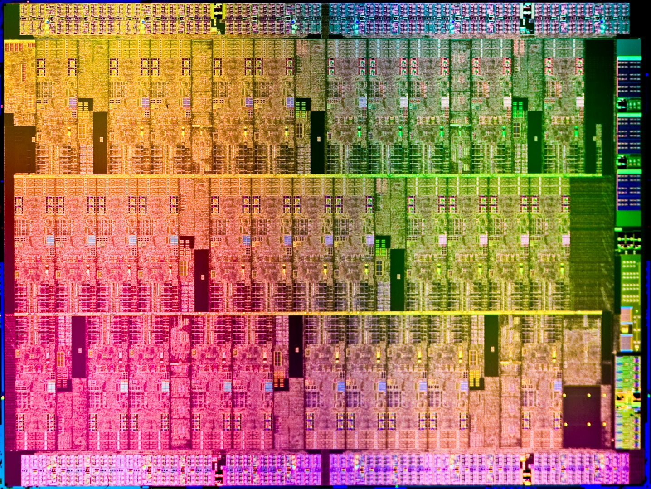
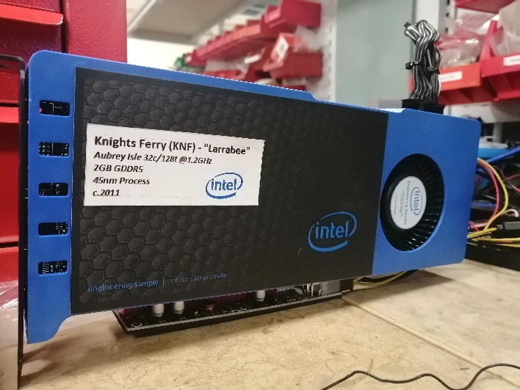
Larrabee 1 – Knights Ferry
Knights Ferry
Shipped 2010, 45nm
32 cores
Some disabled for yield
8 texture units
HDMI/DVI scanout
1.2GHz, 1.2TFLOPS
“Aubrey Isle” PCIe card

Slide 63
Larrabee 1 – Knights Ferry
A-stepping: first working silicon
New architecture = a whole bunch of bugs
I$ broken, x87 was single-thread only, bit scan reverse broken
Fixed in “quick” B-stepping
L1$/L2$ interface had a fundamental flaw hurting memory performance
“Plan to throw one away; you will anyhow” – Fred Brooks
D-stepping – the big fix
Significant re-engineering
Fix the L2$ speed path, misc other bugs
Add some new instructions (gather prefetch, delay)
Not enough float64 performance, never made into a product
But Aubrey Isle used extensively as a SW development vehicle

Slide 64
Delay instruction
When a thread mispredicts a branch or misses cache, it is put to sleep
But we only discover this happens late in the pipeline
There will be other instructions from the same thread queued up
They need to be crushed into NOP instructions
But they still take time to execute & steal clocks from other threads
Similar to existing PAUSE instruction
But delay also takes a number of clock cycles
As soon as it is decoded, it stops picking instructions from that thread
Thread is then put to sleep for the given number of clocks
Pair with a mispredicted branch or a load/store that misses the cache a lot

Slide 65
Larrabee 2 – Knights Corner
Knights Corner started immediately after KNF A-step
Focused more on HPC market
Name changed to “Xeon Phi” to reflect this
Switch process 45nm -> 22nm
Faster in every way
4x float64 performance for HPC market
More gather/scatter performance
Bigger TLBs, faster L1$, faster L2$
Nearly double the core count, and more complex ring topology
New “MVEX” encoding to be friendlier to Big Core

Slide 66
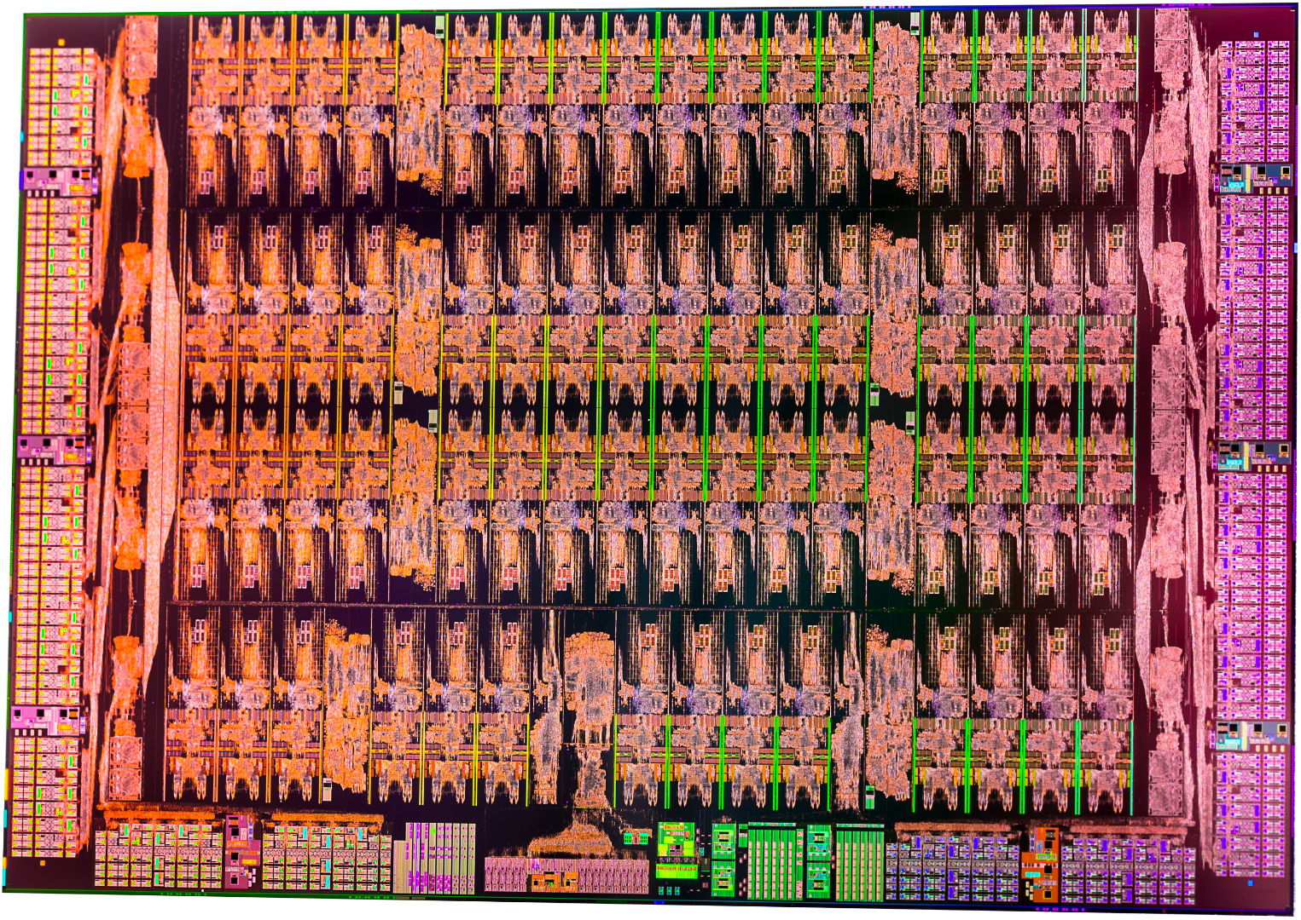
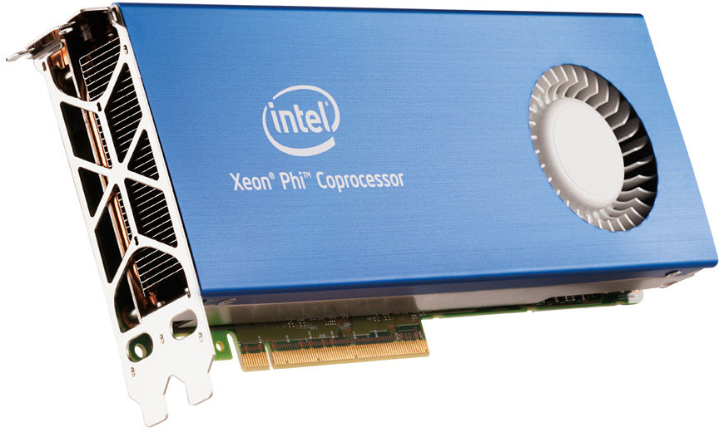
Larrabee 2 – Knights Corner
Knights Corner
Shipped 2012, 22nm
62 cores
Some disabled for yield
Only 8 texture units
No scanout
1.2GHz, 2.4TFLOPS
“Xeon Phi” PCIe card

Slide 67
Knights Landing
Knights Landing goals:
100% x86 compatibility and “bootable”
Out-of-order processing
2x peak flops per core
Replace P54C core with Silvermont “Atom” core
MMX and SSE already present
Standard modern debugging, profiling, etc
Motherboard chipset support
Higher frequency
“Bootable” – can be only CPU in the system, boots Windows etc
New “EVEX” encoding – true AVX512 convergence with Big Core

Slide 68
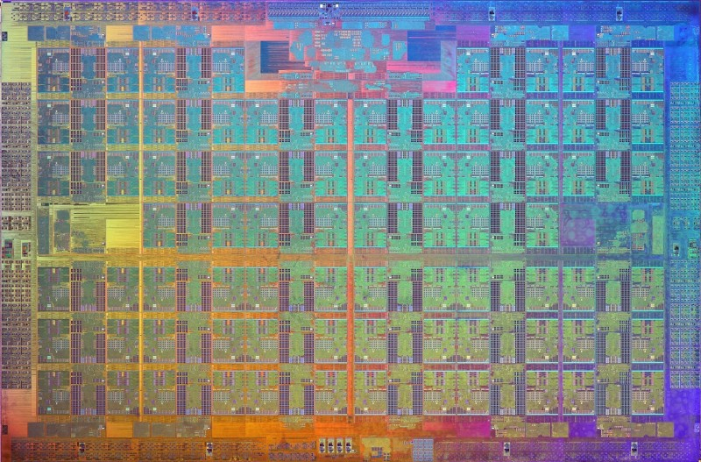
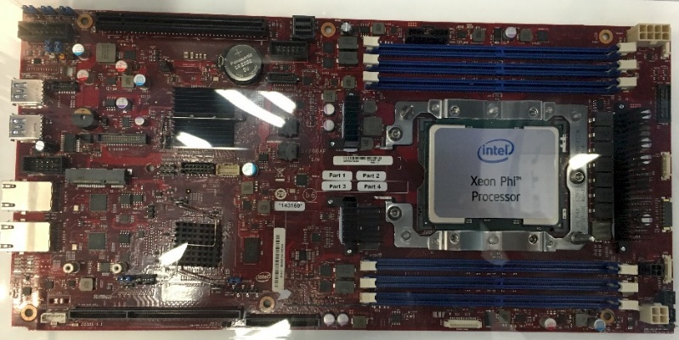
Knights Landing
Knights Landing
Shipped 2016, 14nm
76 cores
Some disabled for yield
No texture units
No scanout
1.5GHz, 7.3TFLOPS
Motherboard!

Slide 69
Knights Mill
Knights Mill
Shipped 2017, 14nm
Closely based on Knights Landing
Reduced double-precision support, to make room for…
Doubled single-precision performance
Even higher performance for 16-bit formats
Aimed at machine learning applications rather than HPC

Slide 70
Conflict
Parallelize a loop with possible dependencies, e.g. histogram:
for ( int i = 0; i < 1024*1024*16; i++ )
{
int index = data[i];
int x = histo[index];
x++;
histo[index] = x; }

Slide 71
Conflict
Parallelize a loop with possible dependencies, e.g. histogram:
for ( int i = 0; i < 1024*1024*16; i++ )
{
int index = data[i]; What if data[] is {1,5,6,7,1,8,9,5}?
int x = histo[index];
x++;
histo[index] = x; }

Slide 72
Conflict
Parallelize a loop with possible dependencies, e.g. histogram:
for ( int i = 0; i < 1024*1024*16; i++ )
{
int index = data[i]; What if data[] is {1,5,6,7,1,8,9,5}?
int x = histo[index];
x++;
histo[index] = x; histo[1] and histo[5] only +1, not +2! }

Slide 73
Conflict
The problem is doing the +1 multiple times in parallel
This is a “hidden” dependency that cannot be parallelized
We need to spot when we have conflicting indices
Mask out all but the first conflicting lane
Keep doing the operation until all conflicts resolved
Simple version:
vconflict k1, v0 v0={1,5,6,7,1,8,9,5}
k1={1,1,1,1,0,1,1,0} Disable conflicting lanes
Actual AVX512 implementation is slightly more complex
This allows vectorization of a lot more types of loops

Slide 74
Conflict
All-to-all comparison
Architecturally, this looks really complex
Dismissed for KNC – too expensive – emulated slowly with scatter/gather
But then a smart designer called Dennis Bradford looked at it
Huh, this looks somewhat familiar…

Slide 75
Conflict
All-to-all comparison
Architecturally, this looks really complex
Dismissed for KNC – too expensive – emulated slowly with scatter/gather
But then a smart designer called Dennis Bradford looked at it
Huh, this looks somewhat familiar…
In fact, we can re-use an existing structure with some minor changes
The two look totally different architecturally (i.e. in terms of math)
But at the design level (gates and wires) they look very similar
Both are “hard” but a very similar sort of “hard”
Dennis had already solved the problem once, which is why he recognized it
vconflictd turned out to be very cheap to add to KNL

Slide 76
AVX512
Finally achieved consensus on shared ISA!
So… many… meetings…
Big cores struggled mightily with predication
Merging is more expensive when doing OOO register renaming
Much discussion over whether to only support zero-predication
Feedback from SW convinced them the effort was justified
Still some areas of AVX512 that are optional
KNL/KNM have higher-precision recip/sqrt, more prefetch options
Big cores have more complete byte, word, DQ support
And of course there will be new additions in the future

Slide 77
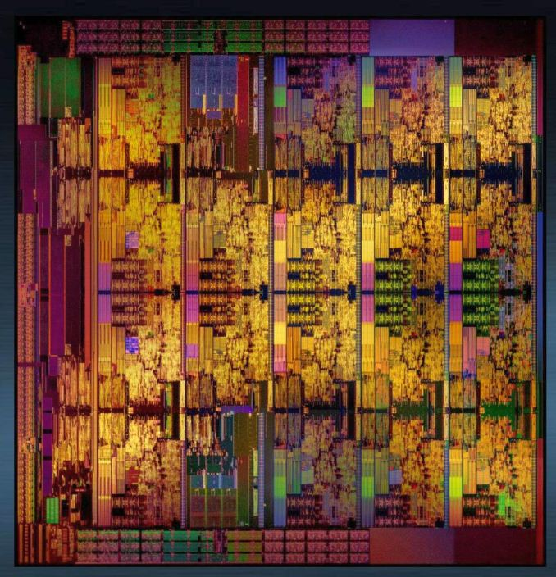
“Big Cores”
Skylake Xeon (SKX)
Version of Skylake for servers
Shipped 2017
Variety of core counts and clock speeds
First big core implementation of AVX512
Canon Lake
Shipped 2018
Variety of core counts and clock speeds
First laptop/desktop big core to support AVX512
…and nearly everything since

Slide 78
Lessons – lean on the compiler
Write the compiler first!
There’s a lot of smart ideas that a compiler cannot deal with
There’s some ugly ideas that it can use well, e.g. madd233
Many tradeoffs are very marginal
Especially in “embarrassingly parallel” workloads
If a single instruction would cost 1% area, it needs to produce 1% speedup
Because the alternative is you add 1% more cores instead!
Having a compiler gives you a big dataset
Intuition about instruction frequency can be misleading
Iteration speed is vital
You have to wade through a lot of bad ideas to find the good ones
May have to try a lot of combos to discover instruction synergy

Slide 79
Lessons – every level of HW shapes an ISA
Design
In-line swizzles (don’t!)
Conflict – cheaper than thought
Micro-architecture (“uarch”)
Load-op and fat/thin pipe inherited from P54C
Slow microcode -> multi-instruction recip/sqrt/etc -> fixup instruction
User-level architecture
FMA and ternary efficiency
Predication

Slide 80
Questions?

Slide 82
Backup slides
Interesting, but moved out of the main presentation for time reasons

Slide 83
Historical context
Because architecture is always created in a context, this talk is a historical journey, as well as a technical one.
Timeline of roughly when the ISA work was done (not when it shipped!):
2004: Pixomatic
2005: SMCANI – SMCA New Instructions
2008: LRBNI – Knight’s Ferry (KNF, MIC)
2010: LRBNI2 – Knight’s Corner (KNC, XeonPhi)
2013: AVX512 – Knight’s Landing (KNL, KNM, XeonPhi 2)
2015: AVX512 – Big Cores (SKX, CNL)

Slide 84
Predication masks
Predication is crucial for efficient wide SIMD, used by all GPUs
Deactivate unused ALU lanes to save power
Do not signal exceptions/flags for disabled lanes
Avoids extra instructions to merge results
vaddps v0, v1, v2 All 16 lanes do operation & store to v0
vaddps v0{k1}, v1, v2 Some v0 lanes preserved, ALU lanes inactive
Most GPUs have an implicit “current” write mask
But implicit registers have caused enough trouble in x86!
Direction flag, rounding mode settings, etc
Decided to use explicit registers instead

Slide 85
Predication masks
vaddps v0{rax}, v1, v2 Use existing registers for predication?
vaddps v0{k1}, v1, v2 Invent new registers?
Really wanted to use rax/rbx/rcx/rdx, but worries about timing
New registers k0-k7 and new mini-ISA to manipulate them
In retrospect, we could have made rax-rdx work on P54C
But would have bitten us when making AVX512 on the Big Cores
So a bullet dodged by luck, even though it felt ugly at the time
Only 3 bits of encoding space
Thus 8 registers
000 = “no predication”, so k0 could not be used for predication

Slide 86
Conflict
for ( int i = 0; i < 1024*1024*16; i++ )
{
int index = data[i];
int x = histo[index];
x++;
histo[index] = x;
}
mov rcx, #1024*1024
loop_label:
vloadpi v0, [rax]
add rax, 64
vkmov k1, #FF
vgather v1{k1}, [rbx+v0]
vaddpi v1, #1
vkmov k2, #FF
vscatter [rbx+v0]{k2}, v1
dec rcx
jnz loop_label

Slide 87
Conflict
mov rcx, #1024*1024
loop_label:
vloadpi v0, [rax]
add rax, 64
vkmov k1, #FF
vgather v1{k1}, [rbx+v0]
vaddpi v1, #1
vkmov k2, #FF
vscatter [rbx+v0]{k2}, v1
dec rcx
jnz loop_label
Problem:
what if histo[] = {10, 11, 12, 13} and v0 = {1, 2, 3, 1}?
v1 = {11, 12, 13, 11}
v1 = {12, 13, 14, 12}
histo[] = {10, 12, 13, 14}

Slide 88
Conflict
mov rcx, #1024*1024
loop_label:
vloadpi v0, [rax]
add rax, 64
vkmov k1, #FF
vgather v1{k1}, [rbx+v0]
vaddpi v1, #1
vkmov k2, #FF
vscatter [rbx+v0]{k2}, v1
dec rcx
jnz loop_label
Problem:
what if histo[] = {10, 11, 12, 13} and v0 = {1, 2, 3, 1}?
v1 = {11, 12, 13, 11}
v1 = {12, 13, 14, 12}
histo[] = {10, 12, 13, 14}
…but the correct answer should be:
histo[] = {10, 13, 13, 14}
…and the problem is the duplicated index “1” in v0

